Slide 1

Royal Sports Club
Project By:
Hrishikesh Kadam
Roll_No:23(Akurdi)

Slide 2

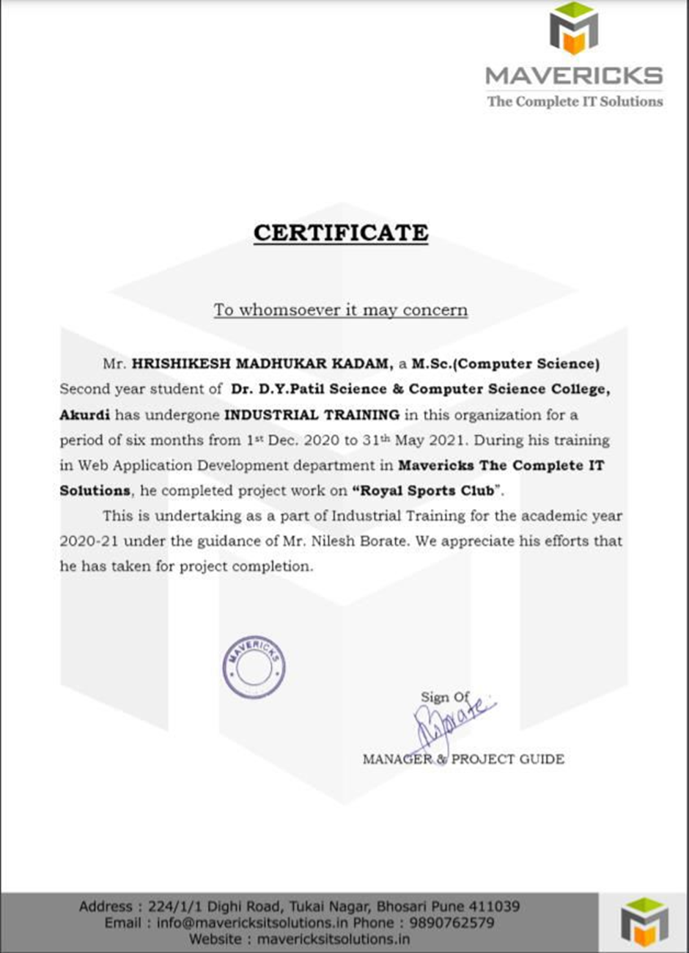

Company Certificate

Slide 3
Introduction
We have developed an Online E-commerce website named as Royal Sports Club.
This project deals with developing an e-commerce website for Online Product Sale.
It provides the user with a catalog of different sports equipments available for purchase in the store online.
This is a project with the objective to develop a basic website where a customer can register, login, view the product related to Sport’s and buy the product online, and also customer is provided with a shopping cart.
Admin can add the product according to the product category or product type.
The primary goal of an e-commerce site is to sell goods online, provide best quality products to customer. E-commerce allows you to reach customers all over the country and our customers can make a purchase anywhere and anytime.

Slide 4
Motivation
Computer has become the most necessary part of business market. It plays an important role in our day-to-day life.
We are trying to develop Software as “Royal Sports Club”. In this Online Website every task is done fluently, securely. So that the processing time get reduce & get required proper output is done in the given time.
Using this Software we can store all information related to Purchase order, Inward, Outward, Bill Records etc.
We have designed our Project on the basis of the facts & requirements collected from our Client. The manual system use in most of the Shop has the following problems:
Difficulty in updating of records.
Difficulty in keeping the Product Bill information specifically about Item price, Bill no etc.
Difficulty in handling the Party Info.
There is always chance of data redundancy & data inconsistency.
Difficulty for deleting any particular record.
There is always a chance of error.

Slide 5
Problem statement
There are several reason hinder in the consumer are involved in online shopping because some of the consumer are not willing to take part in online purchased due to the valid reason because they are worried about the quality of the product in online are not durable.
Lack of security - Cyber security, or more precisely the lack of security, is a major problem on the internet today. E-commerce sites record important customer data like name, phone number, address, and bank details.

Slide 6
Objectives/Goals
So the main objective of the software is:
Provide best quality products to customer.
Customer details and best offers.
User friendly interface.
Promoting Small businesses.
Bill Generation.
Boosting the efficiency of services.
Making responsive ecommerce website.
Increasing sales.

Slide 7
Project Scope
Pre-sales, subcontracts, supply.
User can Easily Navigate through all products.
Business-to-administrations.
Minimizes manual data entry, Reduce Paperwork.
Accounting and financial management.
User Friendly and Interactive interface.
Having a Data Backup

Slide 8
Project Limitations
Security: One of the main limitations of eCommerce is security. In most cases, people are hesitant to provide their personal and financial details in spite of advanced data encryption security systems in place.
Lack of Privacy: To some extent, the privacy of a customer is compromised in eCommerce. You need to provide your personal details, such as an address, telephone number, and so on to the seller. There are still lots of sites that do not have the advanced technology to protect sensitive information.
Fear: In spite of the popularity, there still resides an element of doubt in the mind of people when it comes to online shopping. This is because the customer cannot physically examine the product and is not sure about the features and attributes. This is why a lot of people prefer shopping from physical stores.
Delivery Guarantee: Many people fear that their product might not be shipped or the website might be a fraud. Businesses need to work to build customer trust with reviews, testimonials, etc. to add more value to their website.

Slide 9
Comparative study of existing system
The old methods can be classified into categories which are paper grounded and verbal grounded. For verbal based work, the shopkeeper comes and explain all the product details to that customers, after the selection of product the shopkeeper pass the details to retailers and then owner books the product and then the further process which is time consuming.
Also from owners point of view maintaining data record and the account in physical file are tedious work to do.
Also it is full of risk as anyone can access it and modify the data.
In this method time as well as physical work is required, shopkeepers have to deal with the crowd in there shops.

Slide 10
Scope and limitations of existing system
Most limitations of the business owners are how to manage their business.
Because running your own Sports shop business can be undermined by the very simplest of problems, your ability to manage and of course the inventory of your product is important but without an ability to get the best from those around you then you may be looking at a failure, a costly failure.

Slide 11
Project Features
The website provides significantly new functionality in keeping of several functions, managing the flow of the information and interacting with the result.
The website provides the effective mechanism for integrating many of these tools into a single and is an ideal tool for managing the organization resource effectively.
Proposed project helps to maintain customer details, part details, and daily records customer details.
Fast and Easy Access to Database will allow admin to update the website time to time.
Search Facility will provide better User Experience.
Easy Payment method.

Slide 12
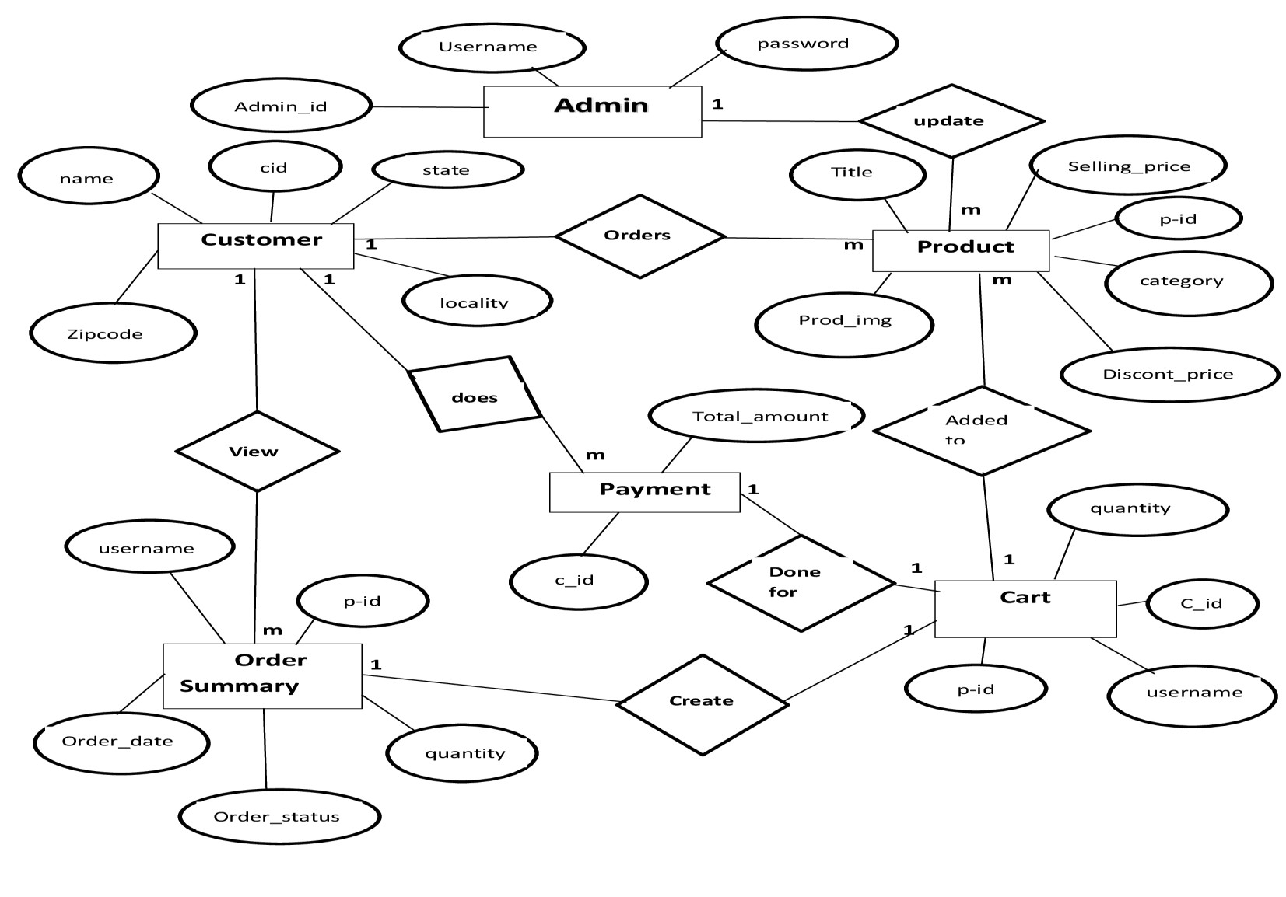
System Design
ER Diagram

Slide 13
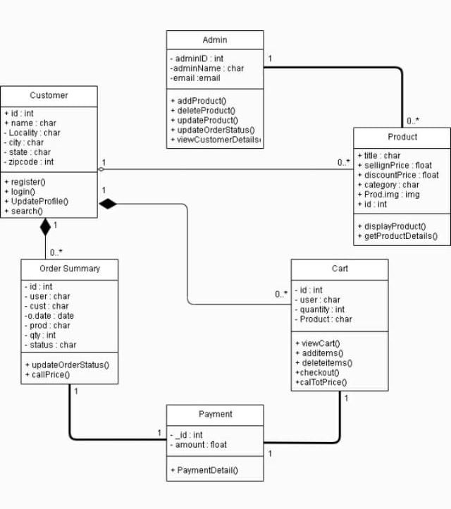
Class Diagram

Slide 14
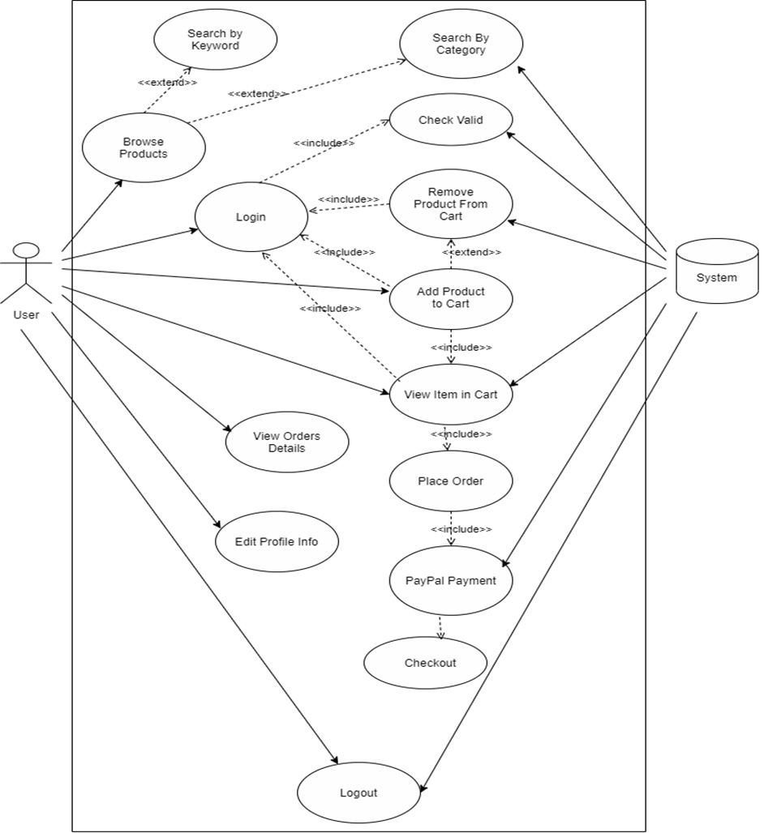
Usecase diagram

Slide 15
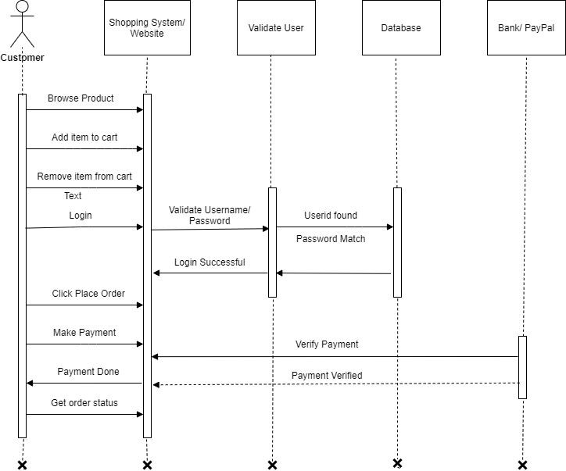
Sequence diagram

Slide 16
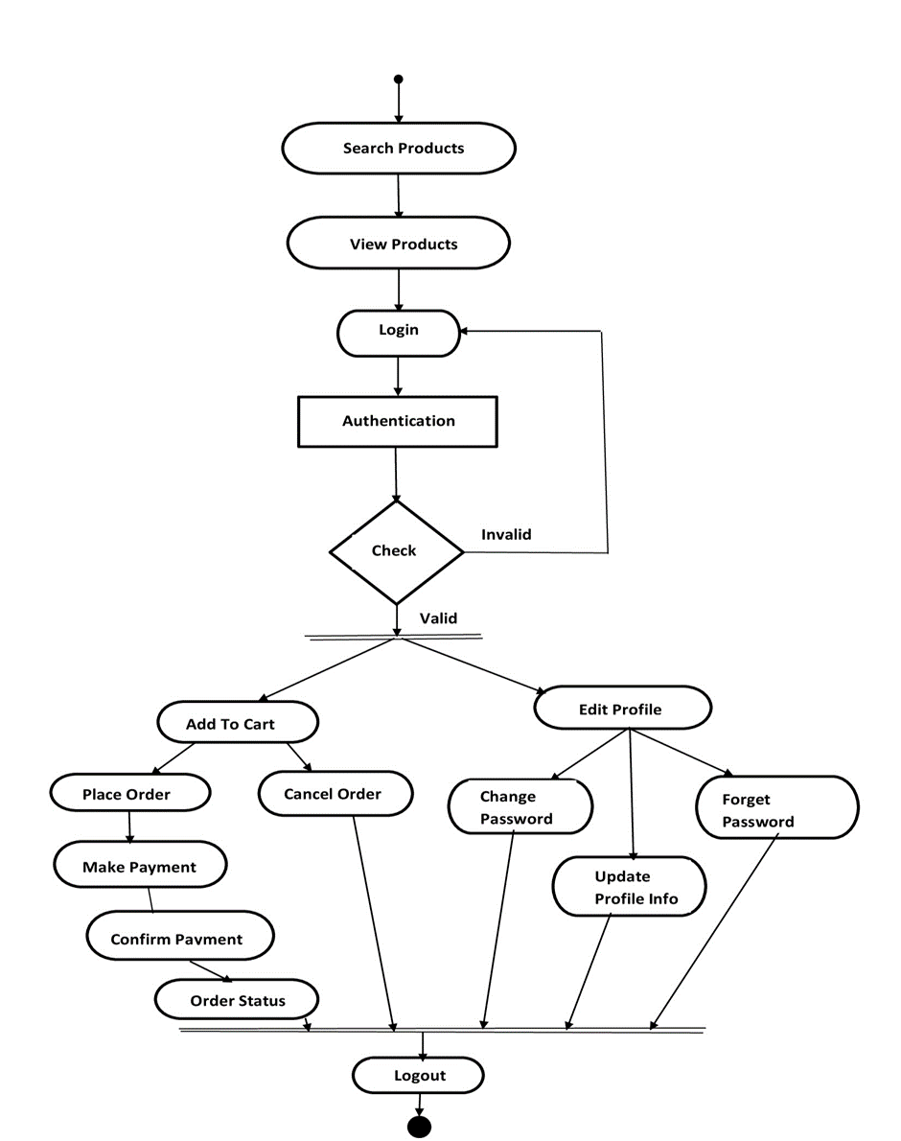
Activity diagram

Slide 17
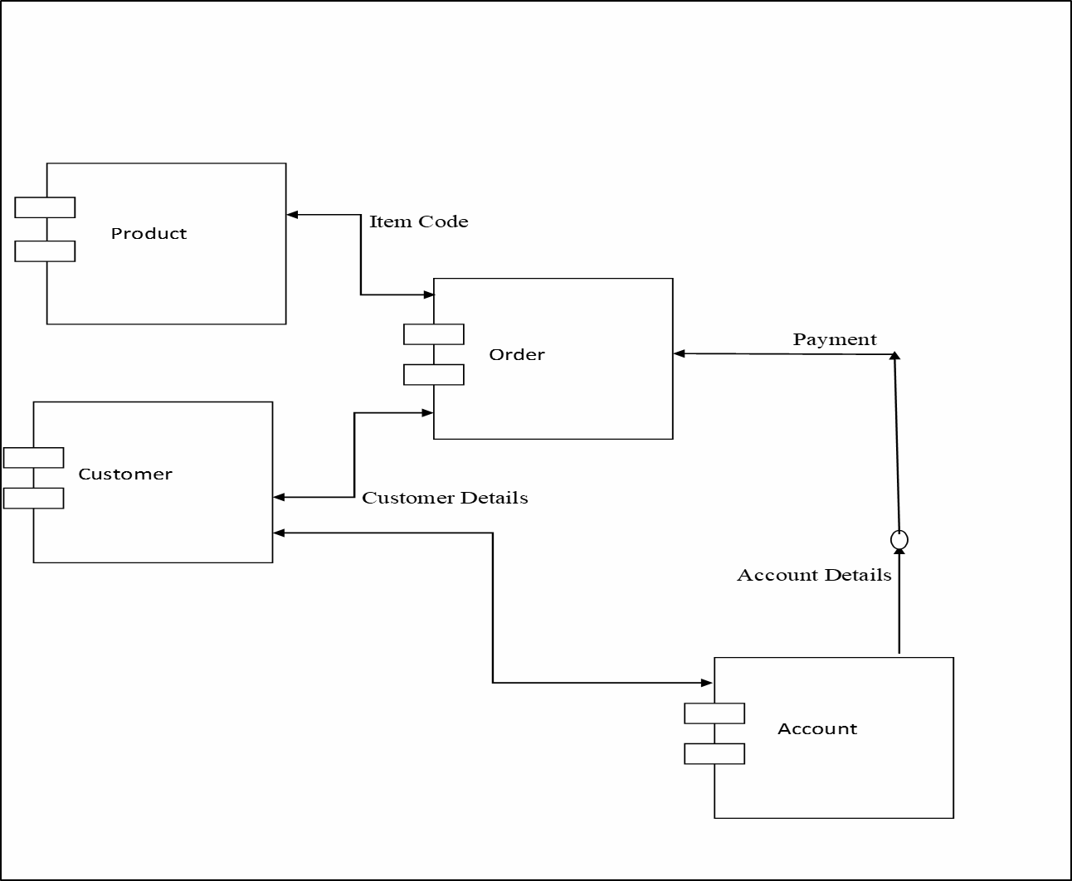
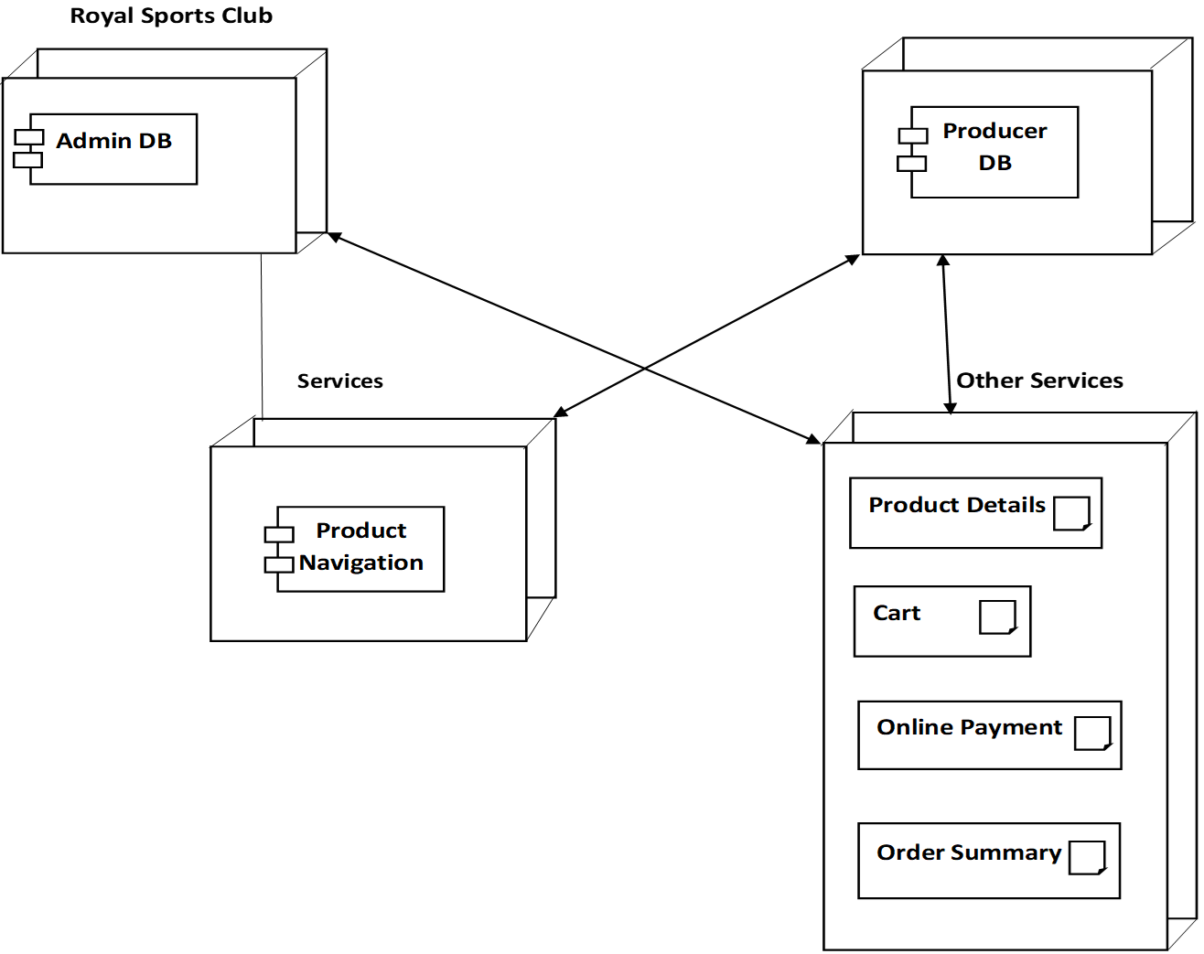
Component Diagram
Deployment Diagram

Slide 18
Data Model
Customer Table
Cart Table
Payment Table
Data Element | Data Type | Description
user | char | Stores the username
name | char | Stores the name of user
locality | char | Stores location of the user
city | char | Stores the city
zipcode | int | Stores the zipcode or pincode of city
state | char | Stores the name of state
Data Element | Data Type | Description
user | char | Stores the username of the user
product | int | Stores the product number of the product
quantity | int | Stores the Quantity of the product
Data Element | Data Type | Description
user | char | Stores the username of the user
product | int | Stores the product number of the product
payment_status | char | Stores the status of the payments

Slide 19
Product Table
OrderPlaced Table
Data Element | Data Type | Description
title | char | Stores title of the product
selling_price | float | Stores the selling price of product
discounted_price | float | Stores the discounted price of product
description | text | Stores the details / description of the product
category | char | Stores the category of the product
product_image | image | Stores the image of the product
Data Element | Data Type | Description
user | char | Stores the username of the user
customer | int | Stores the customer number
product | int | Stores the product number of the product
quantity | int | Stores the Quantity of the product
ordered_date | DateTime | Stores the current date and time when the order is placed
status | char | Stores the status of the orders

Slide 20
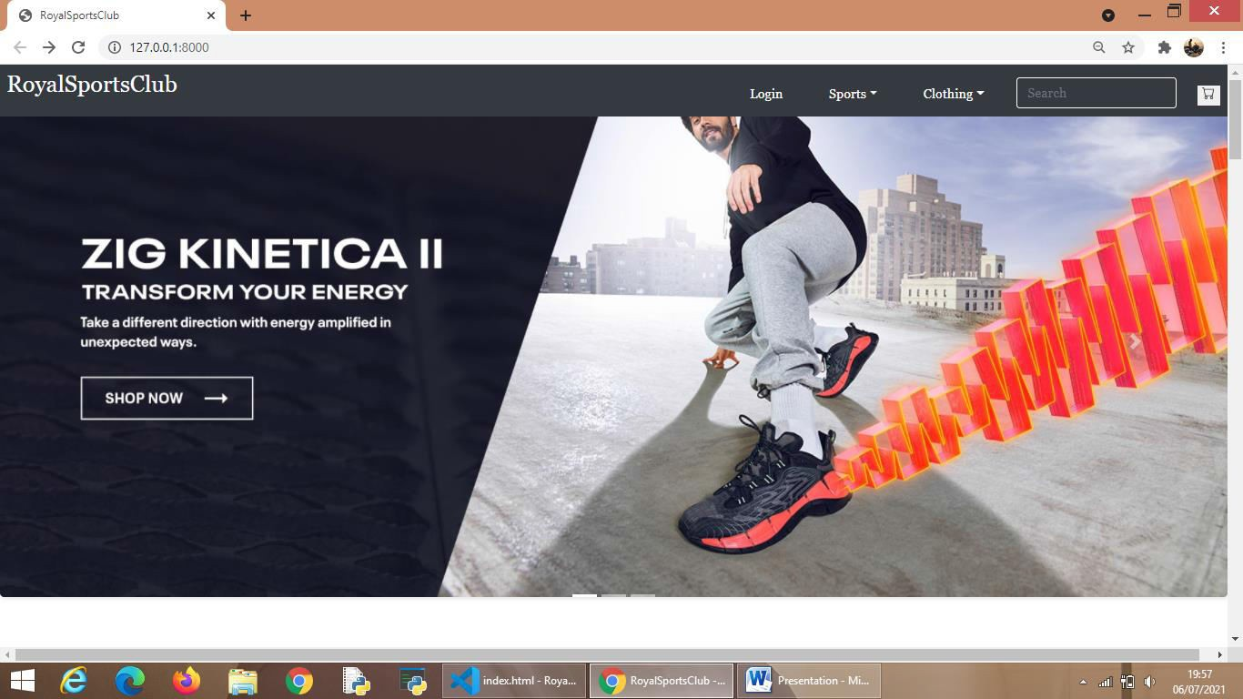
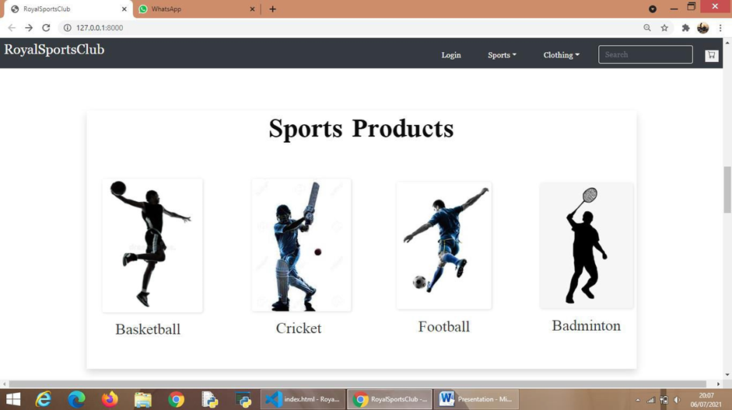
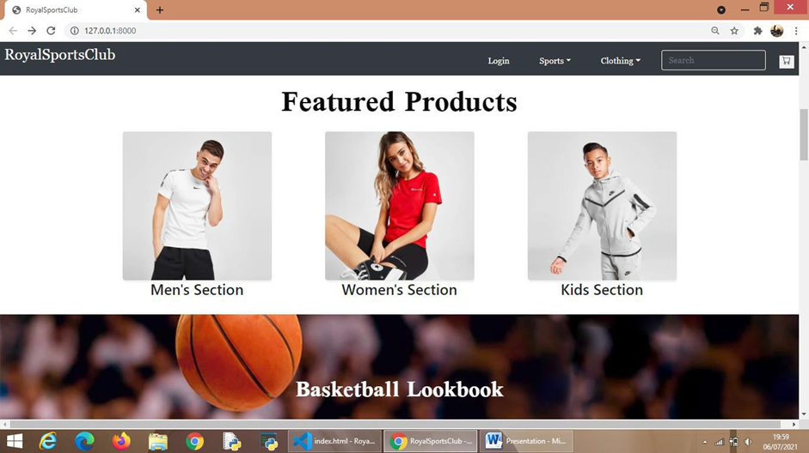
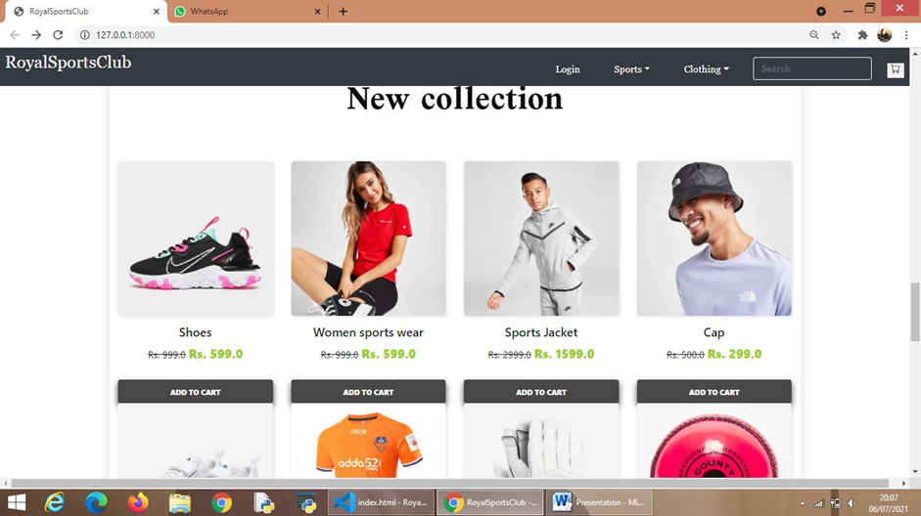
User Interface

Slide 21
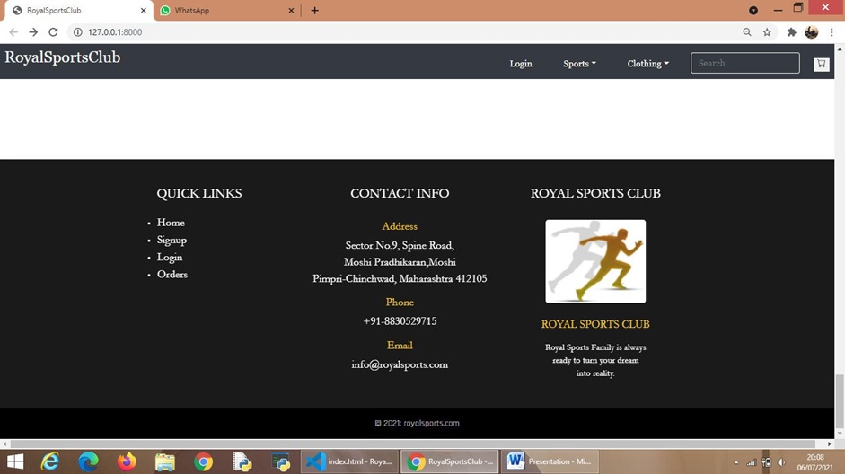
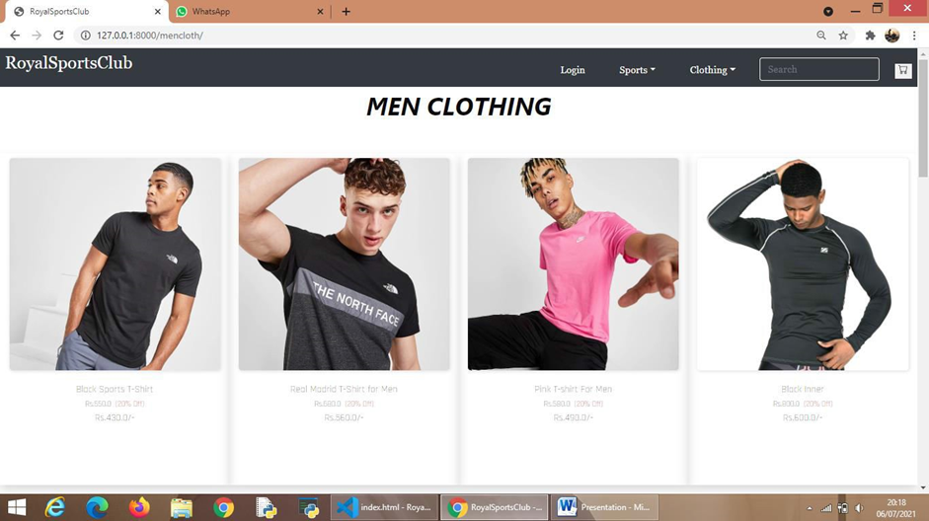
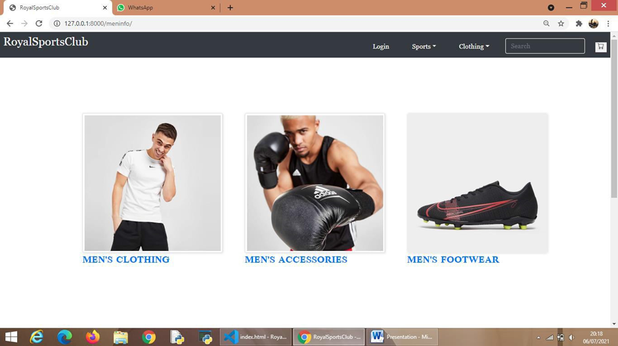
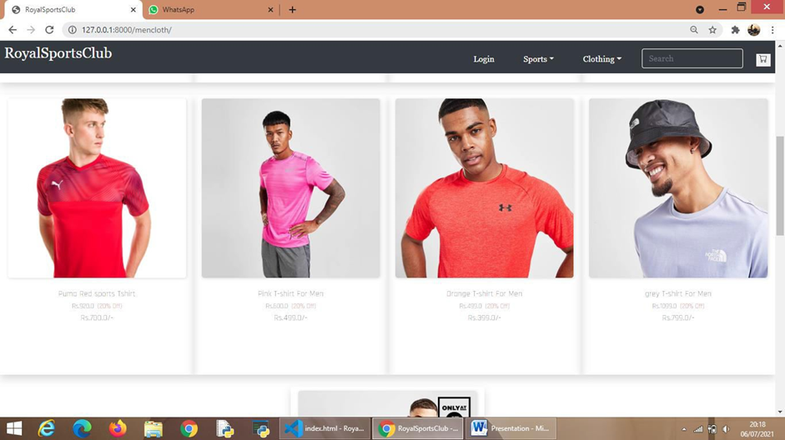

Slide 22
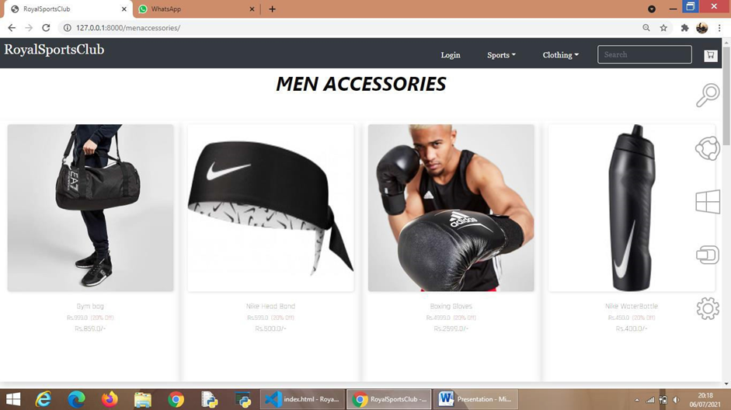
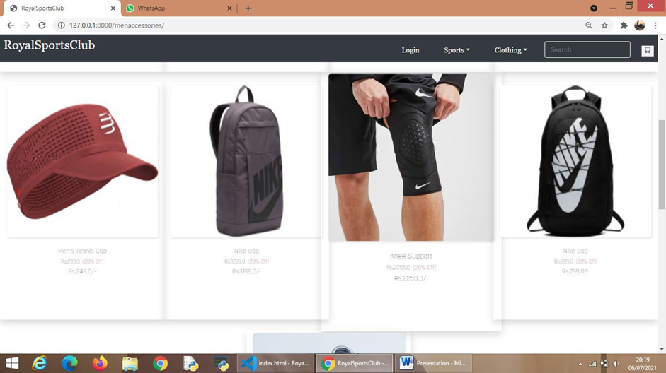
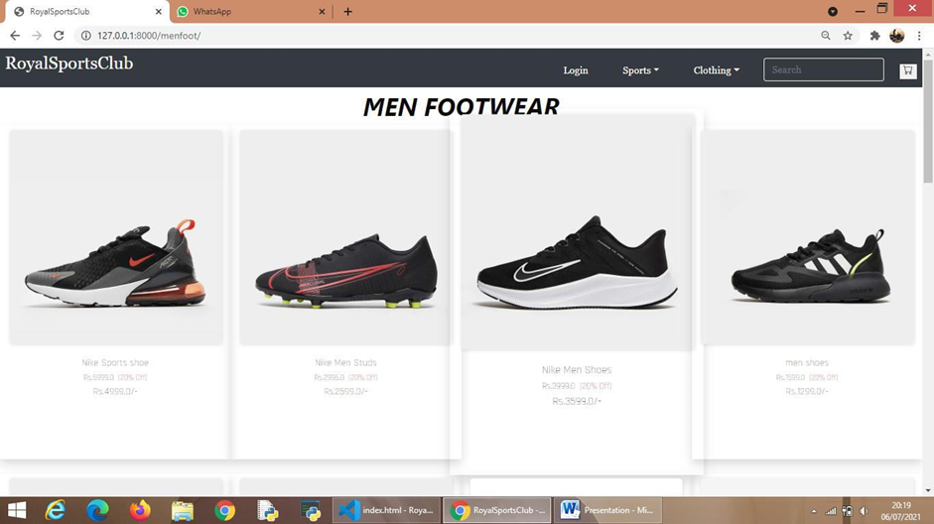
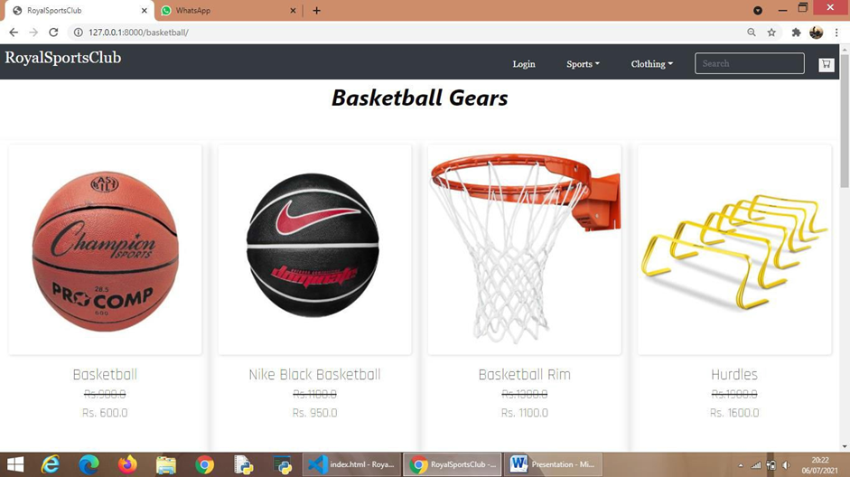

Slide 23
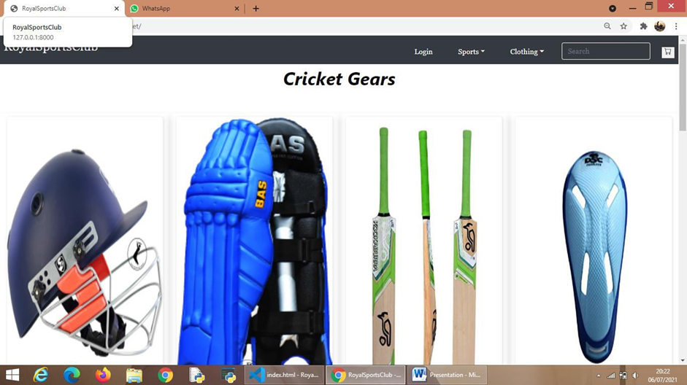
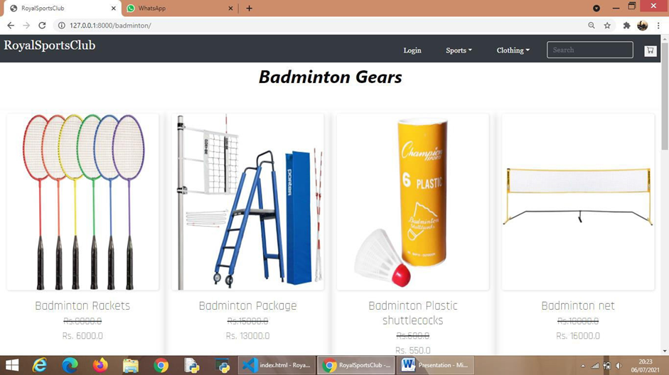
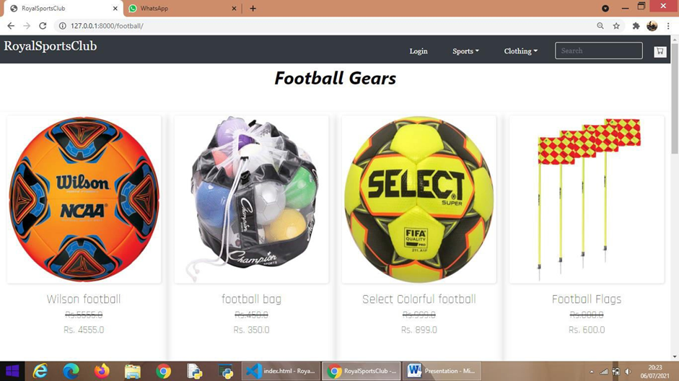
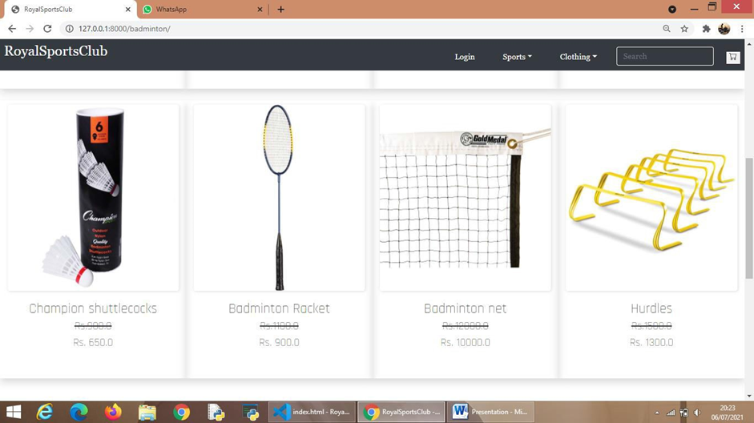

Slide 24
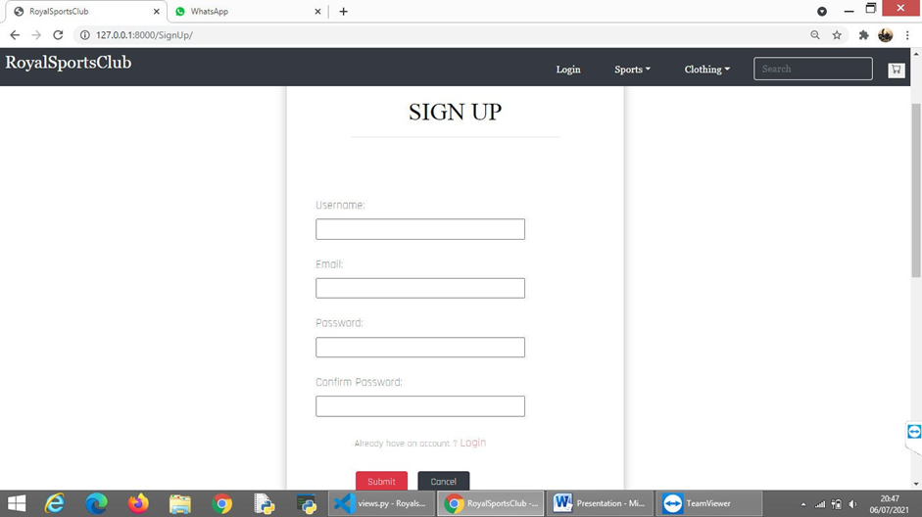
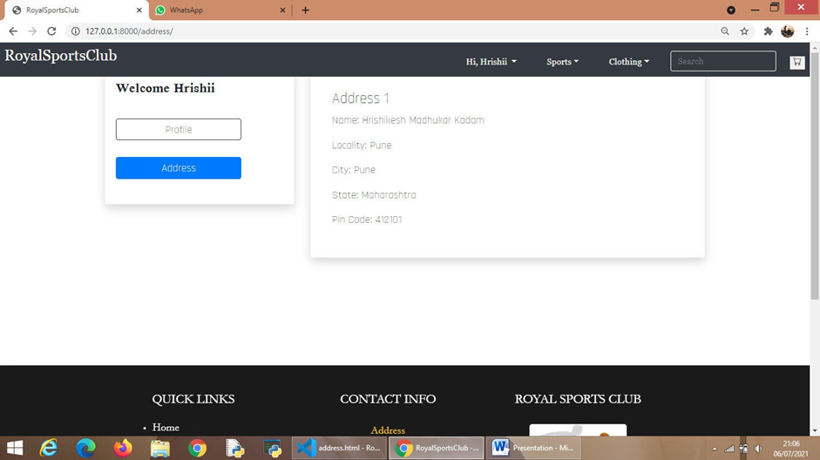
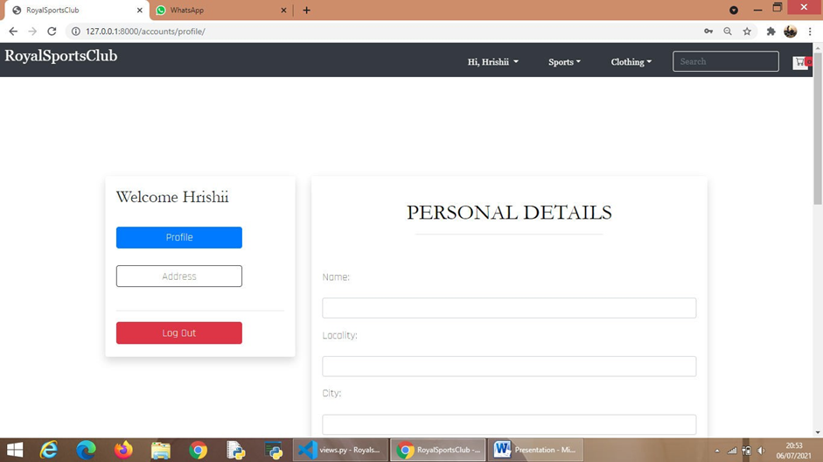
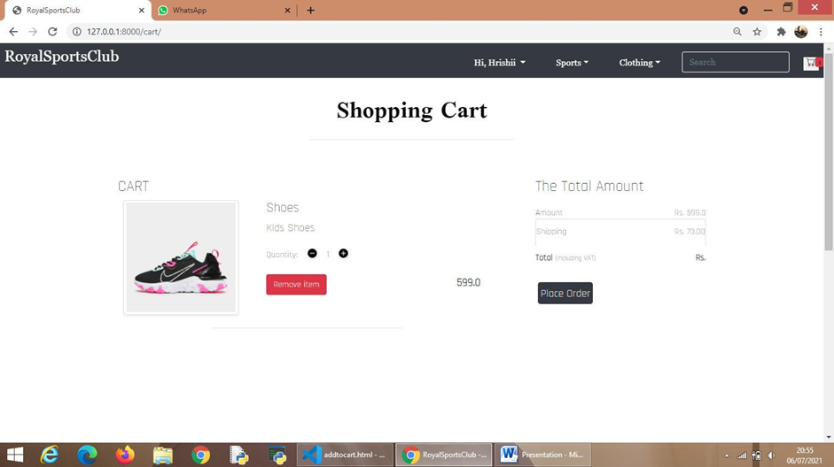

Slide 25
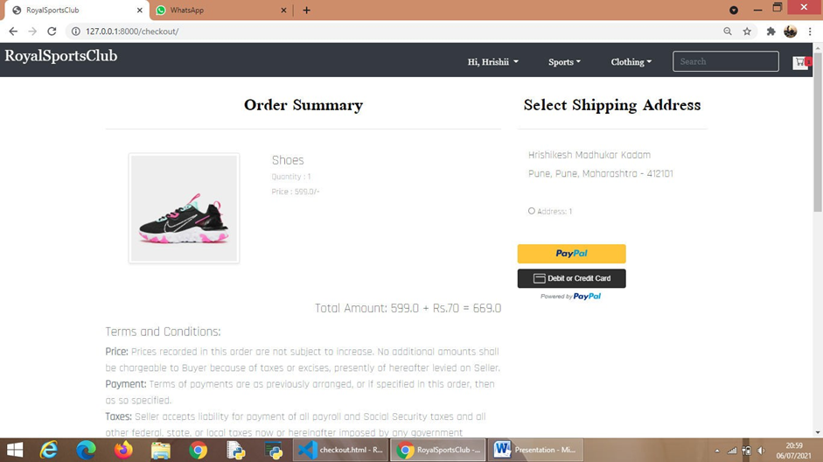
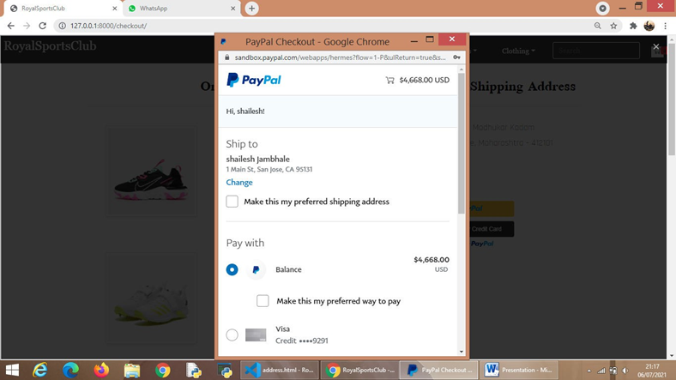
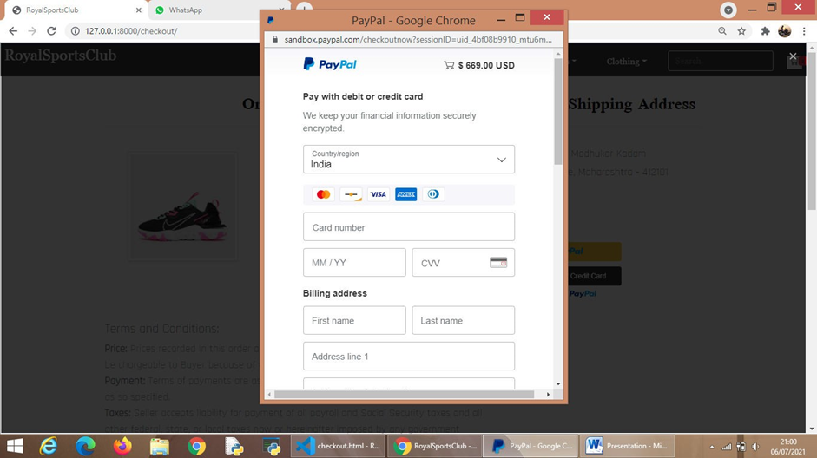
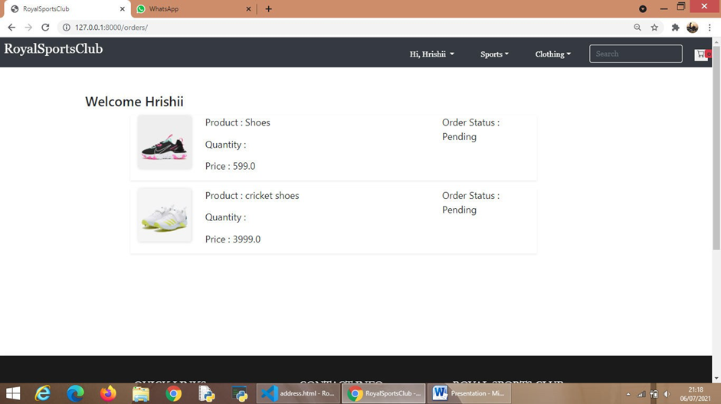

Slide 26
Implementation Details
Software Specification
• Operating System: Windows XP/ Windows 7/ Windows 10/ Linux
Web Technologies: HTML5, CSS, Bootstrap
• Programming Languages: Python-Django
• Database: SQLite
• Tools: Visual Studio Code
• Platform: ANY
Hardware Specification
• RAM: 4GB
• Processor: Intel Dual Core/ i3/ i5/ i7
• Hard Disk: Minimum 4GB

Slide 27
testing
Test data | Expected Output | Actual output
Admin Add/Update Products to Database. | Changes Updated. | Changes get pushed on the actual website.
Test data | Expected Output | Actual output
View products and Add Products to Cart. | Products added to Cart. | Products added to Cart, Cart has Products with Product Details.
Test data | Expected Output | Actual output
Payment through PayPal. | Payment done through PayPal. | Payment is Done and Product Details can be viewed in Order Summary.

Slide 28
conclusion
The project report entitled "Royal Sports Club" has come to its final stage.
A proper care has been taken to avoid any runtime errors. The important thing is that the website is robust.
We have tried our level best to make the system as dynamic as possible.
Also provisions are made for further development in the system. The entire system is secured using various techniques.
This project has given us great satisfaction in having designed an website which can be implemented to any nearby shops or branded shops selling various kinds of products by simple modifications.
The Conclusion of the system is based on user’s need and is user centered. The system is developed in considering all issues related to all user which are included in this system.

Slide 29
Future scope
There is a scope for further development in our project to a great extend.
Including a chat box for public benefit is also a great idea via which people can directly have a conversation with some officials regarding any type of queries.
System have a track of history of purchases of each customer but it can be provide suggestions based on their history.
Also we can add new functionalities for customer, like wishlist option to create personalized collections of products they want to buy and save them in their user account for future reference.

Slide 30

Thank You!

